Slide 1
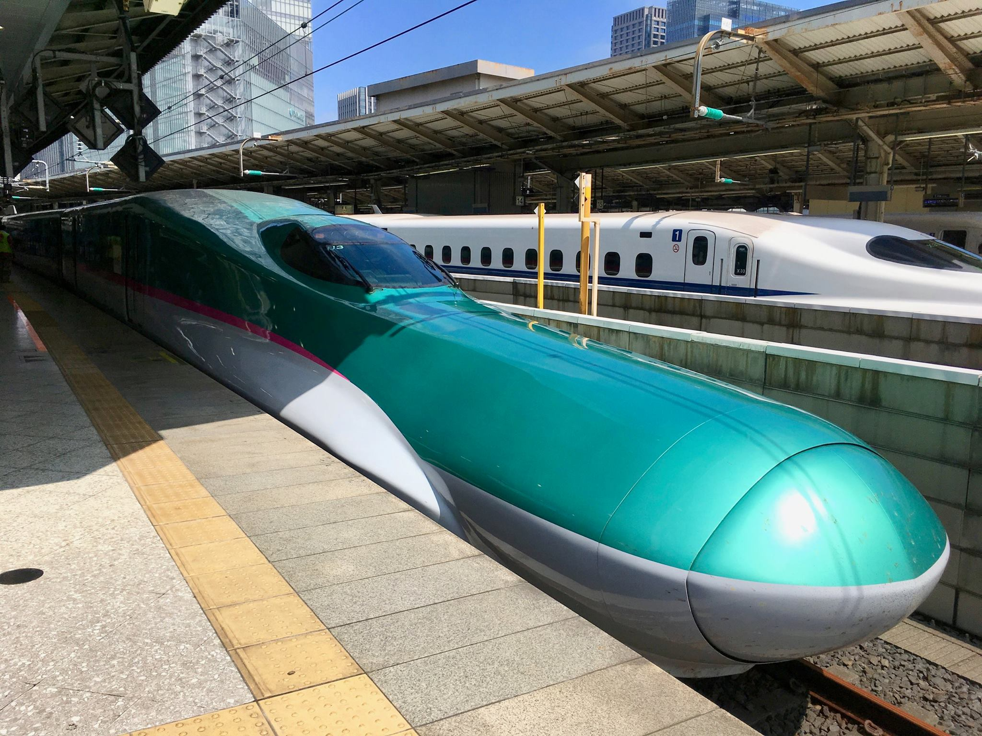
Intermediate Class
Session 16
CES Japanese
日本語

Slide 2
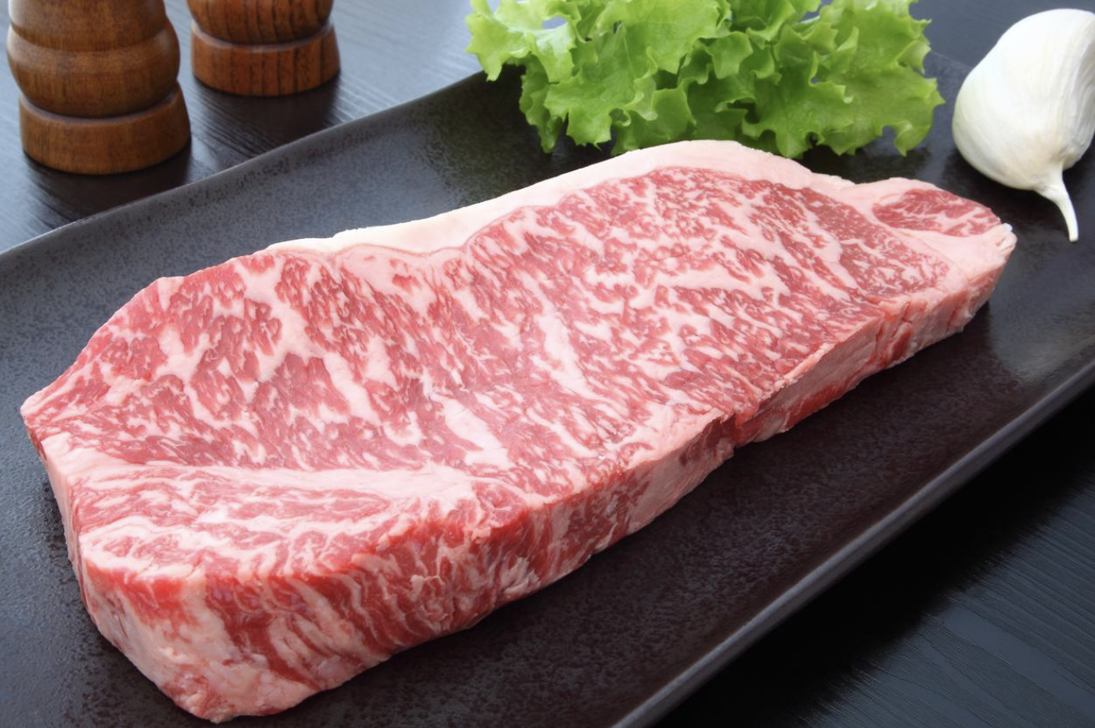
Today’s Menu
Food
Wagyu
Kanji
Listening

Slide 3
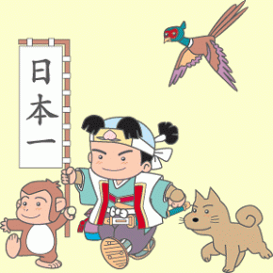
A little break…
の
にほん の せいかつ
nihon no seikatsu

Slide 4
Wa-
和
vs.
Yō-
洋
-shoku
-fuku
-gaku
cooking/cuisine
clothing
music

Slide 5
Wa-gyu
和牛
Japanese Beef

Slide 6
Wa-gyu
和牛
Four types:
Japanese Black 黒毛和種
Japanese Brown 赤毛和種
Japanese Shorthorn 日本短角和種
Japanese Polled 無角和種
Notes:
Washu 和種. Hair ke 毛 Polled from Angus influence, now endangered. Hornless.

Slide 7
Wa-gyu
和牛
Kobe Beef:
Japanese Black
Tajima-Gyu
Born within Hyogo Prefecture

Slide 8
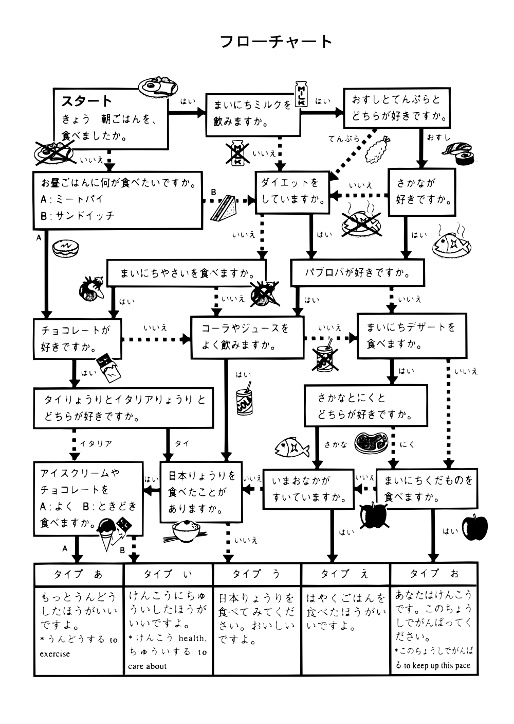

Slide 9
https://www.youtube.com/watch?v=-rieia5B2SE

Slide 10
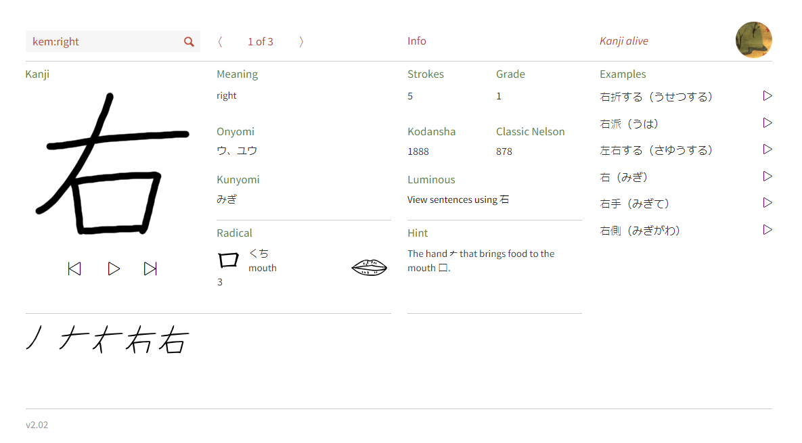
https://app.kanjialive.com

Slide 11
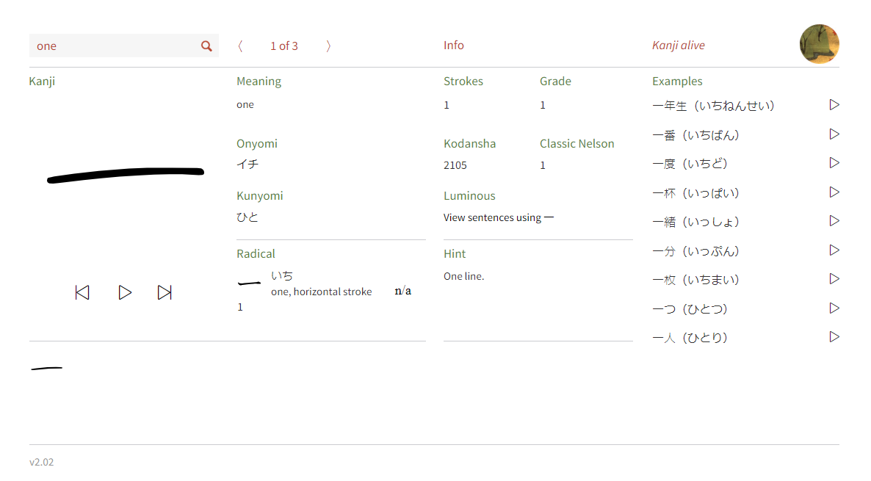
https://app.kanjialive.com

Slide 12
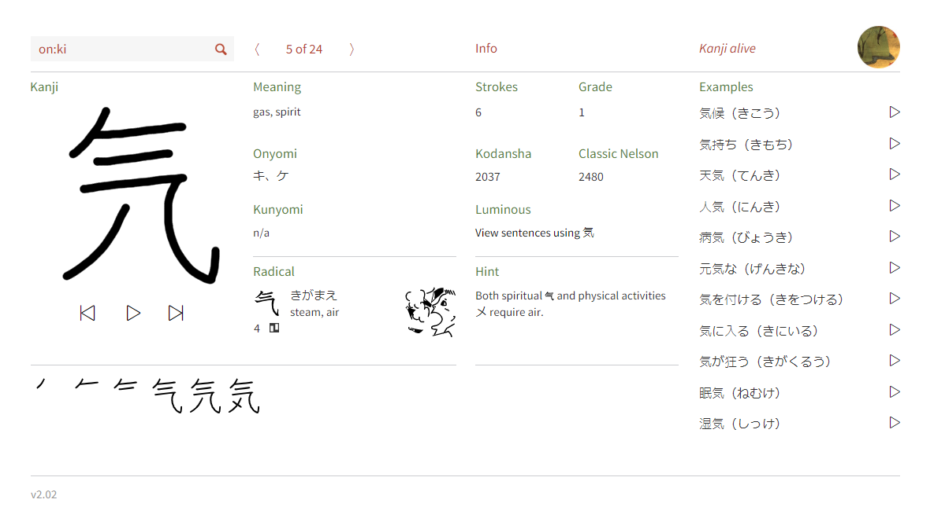
https://app.kanjialive.com

Slide 13
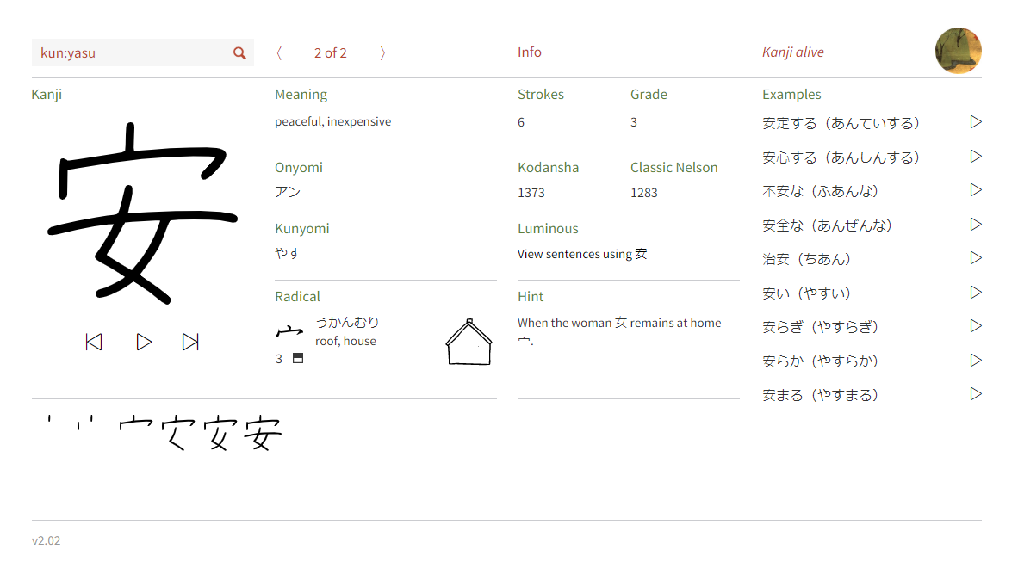
https://app.kanjialive.com

Slide 14
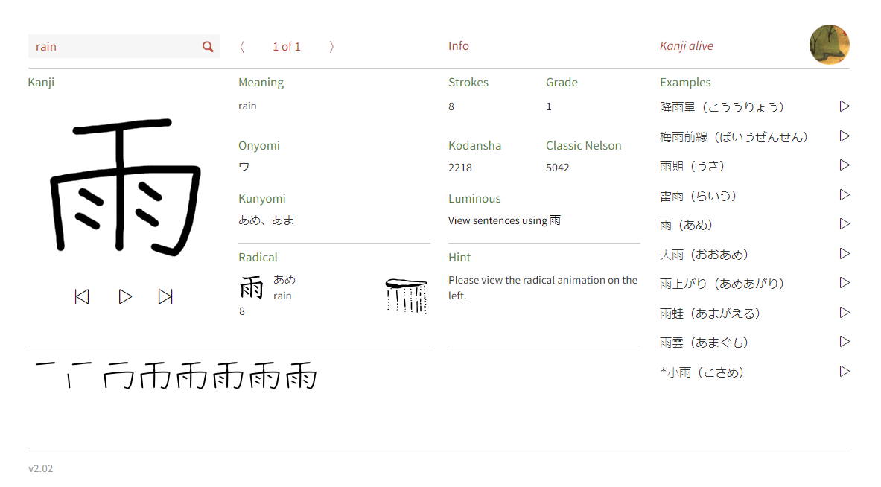
https://app.kanjialive.com

Slide 15
JapanesePod101.com
https://www.youtube.com/watch?v=kEcye1K-MOA
Notes:
https://www.punipunijapan.com/japanese-grammar-tari-tari/
https://www.youtube.com/watch?v=kEcye1K-MOA

