Slide 1
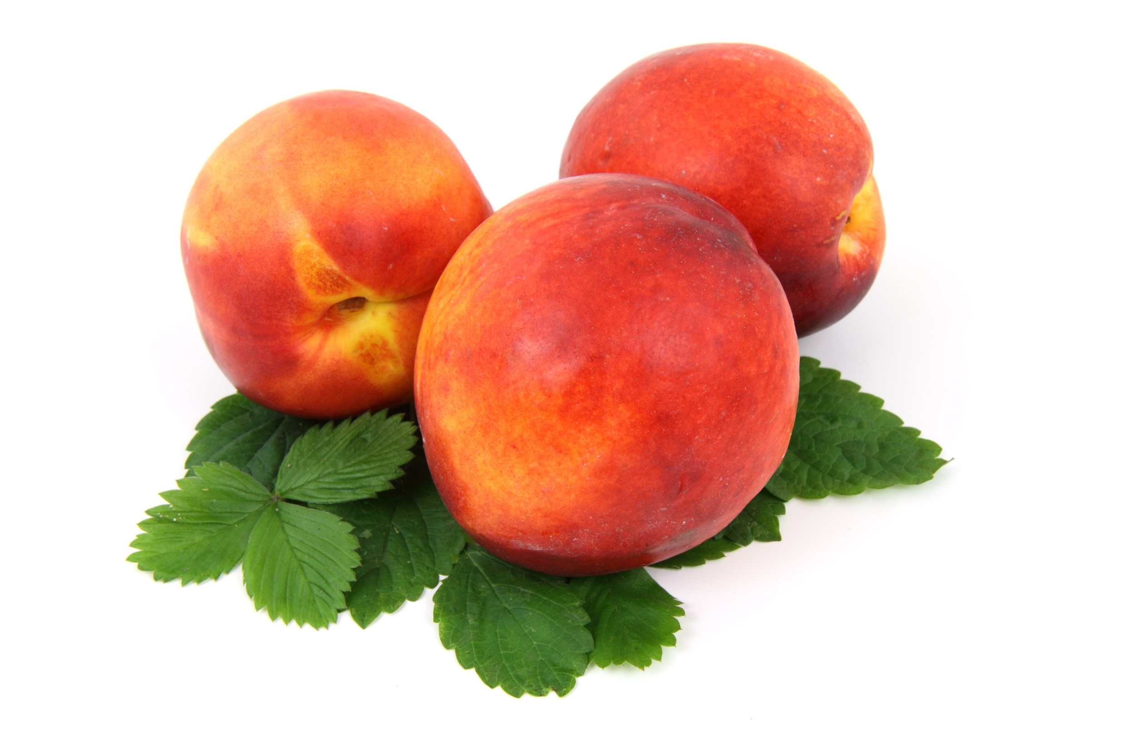
Intermediate Class
Session 14
CES Japanese
日本語

Slide 2
Wednesday 26 February at 2-4 pm in MB0603 (Jackson Lecture Theatre)
Summer Schools in Japan

Slide 4
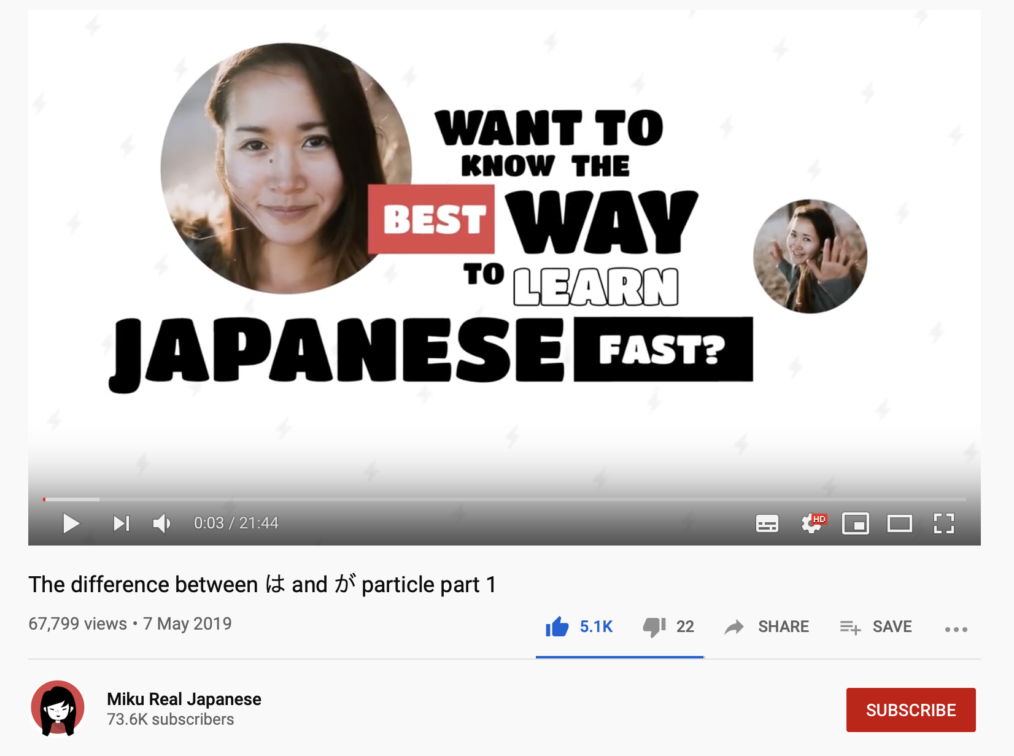

Slide 6
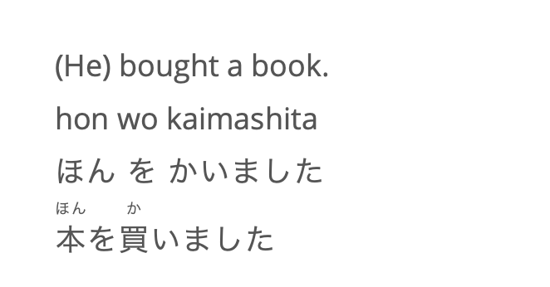
Taro Bought a Book: Three Options
https://8020japanese.com/wa-vs-ga/

Slide 7
Taro Bought a Book: が
たろが本を買いました。
emphasis on the person/thing
が: identifier (“is the one”)
https://8020japanese.com/wa-vs-ga/

Slide 8
Taro Bought a Book: は
たろは本を買いました。
emphasis on the non-topic part
は: topic marker (“as for”)
https://8020japanese.com/wa-vs-ga/

Slide 9
Taro Bought a Book: (nothing)
本を買いました。
(-): topic already clear from the context
https://8020japanese.com/wa-vs-ga/

Slide 10
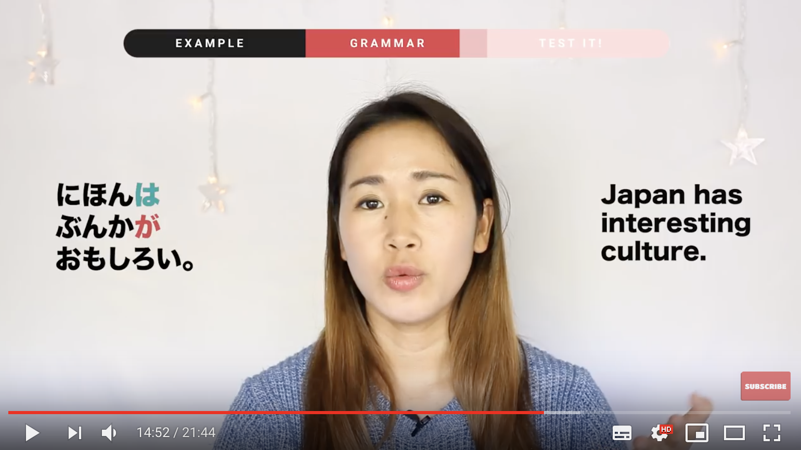

Slide 11
https://www.youtube.com/watch?v=2aqVJS6QOoY

