Slide 1
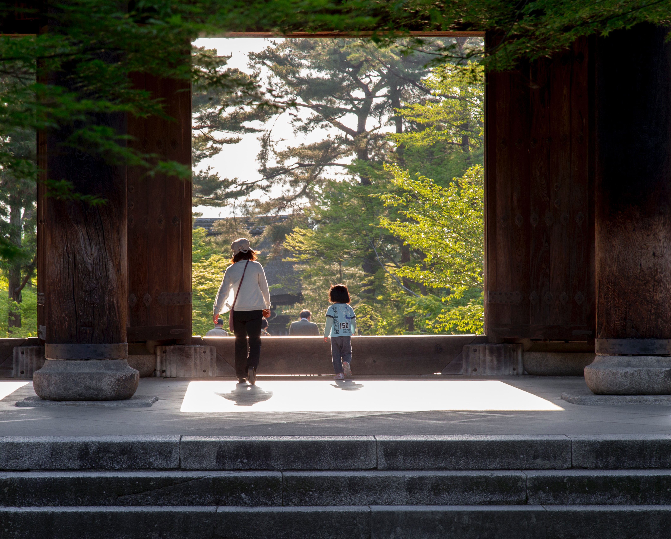
CES Japanese
Intermediate Class
Session 15
日本語

Slide 2
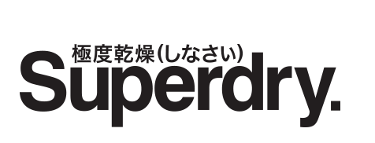
Today’s Plan
Finish the listening test
Review some recent grammar
Review clothing
‘kyokudo kanso (shinasai)’

Slide 3
Vocabulary
Documents
Lawyer
Lunch
Work experience
OK, sorted
shorui
bengoshi
hirugohan, chūshoku
shokuba taiken
kekko

Slide 4
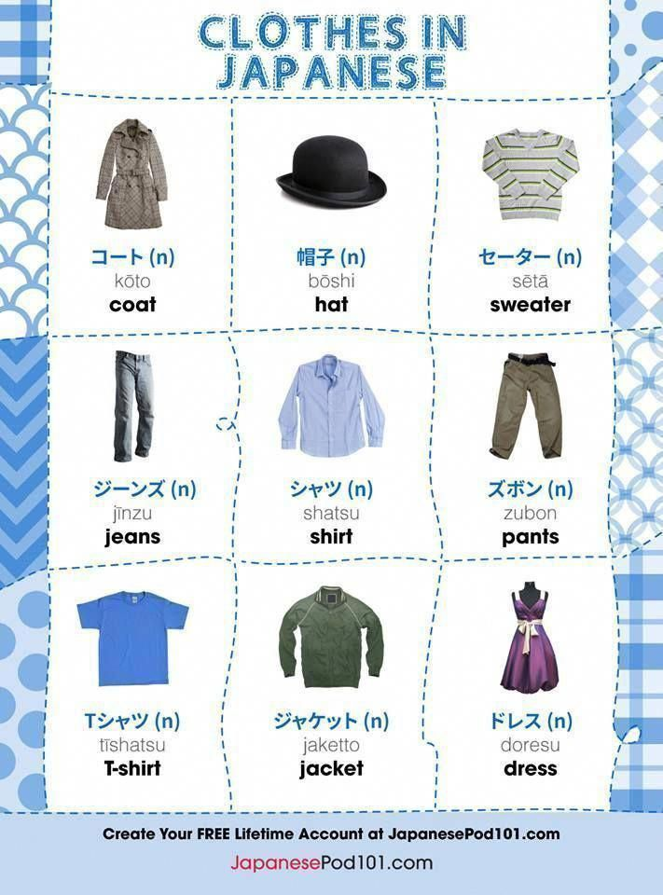
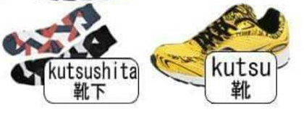
Clothing

Slide 5
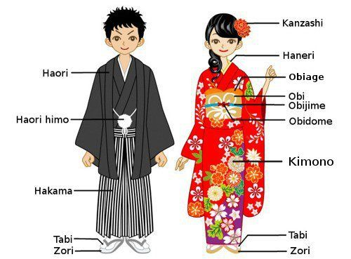
Traditional Clothing

Slide 6
To Wear/Put On
かぶる (kaburu) - hat (i.e. something you wear on your head)
着る (kiru) - jacket, shirt, blouse, dress, suit etc. (i.e. tops and all-over clothes)
履く (haku) - pants, skirts, shoes (i.e. bottoms, including shoes)
かける (kakeru) - glasses, sunglasses
する (suru) - watch, necklace, earrings, ring, belt, necktie, makeup, etc. (i.e. accessories and makeup)
つける (tsukeru) - perfume, cologne

Slide 7
Grammar Quiz
https://www.nihongo-pro.com/quiz/6aa514d99f/jlpt-n5-quiz-more-basic-japanese-grammar

Slide 8
Listening Exam
okurete imasu
kawari ni shinkansen ni notte kudasai
tsugi no shinkansen
shuppatsu ha
atarashii kippu ha irimasen
is/am running late
instead please board the shinkansen
the next shinkansen
departure is
new tickets aren’t needed

Slide 9
Listening Exam
sumimasen ryokan wo yoyaku shitai no desu ga…
Excuse me, I’d like to book a ryokan but…
hidari ni magatte kudasai
Please turn left

Slide 10
Listening Exam
kibishii
sabishii
urusai
yada yo!
lonely
noisy
strict
No way!

Slide 11
Listening Exam
shinkon ryokō
honeymoon
新婚旅行
new
travel

Slide 12
Some Grammar: Conditional…
-ba verbs, -i adjectives
-nara -na adjectives, nouns
hanasu → hanaseba if you talk
taberu → tabereba if you eat
suru → sureba if you do
kurai → kurakereba if it’s dark

Slide 13
Some Grammar: Conditional…
-ba verbs, -i adjectives
-nara -na adjectives, nouns
hima → hima nara if you’re free
ame → ame nara if there’s rain

Slide 14
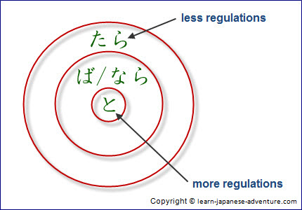
Some Grammar: Conditional…
Also….to and tara!
https://www.learn-japanese-adventure.com/japanese-conditional-form-ba-nara.html

Slide 15
Some Grammar: Must Not…
+
+
dame
ikenai
naranai
-te
ha
それを食べてはだめ！ You can’t (must not) eat that!

Slide 16
Some Grammar: Must…
+
+
dame
ikenai
naranai
negative -te
ha
それを食べなくてはだめ！ You must eat that!
Casual: tabenakucha!
食べなくちゃ

Slide 17
Some Grammar: Must…
+
dame
ikenai
naranai
negative -ba
それを食べなければならない！ You must eat that!
Casual:
tabenakya!
食べなきゃ

Slide 18
Some Grammar: Must…
+
dame
ikenai
naranai
negative -to
それを食べないといけない！ You must eat that!

Slide 19
Some Grammar: Want/Don’t Want
ikimasu I go
ikitai I want to go
ikitakunai I don’t want to go
ikitakatta I wanted to go
ikitakunakatta I didn’t want to go

Slide 20
Some Grammar: Too Much…
-sugiru too…
takai expensive
takasugiru too expensive
genki sugiru too kind
tabesugiru eat too much
tabesugita ate too much

Slide 21
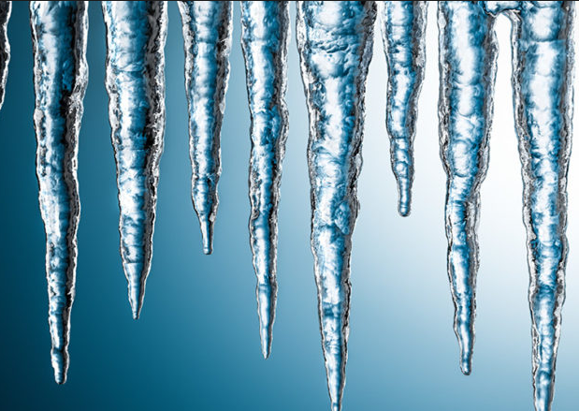
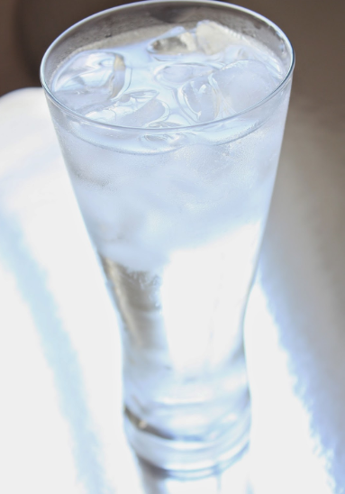
Temperature
atsui
samui
atatakai
tsumetai

Slide 22
Some Grammar: List of adjectives…
atatakakute………..yawarakai
-te form
atatakai → atatakakute (-i adjective)
yumei → yumei de (-na adjective)

Slide 23
Some Grammar: Let’s…
Polite:
ikimasu ikimashō
tabemasu tabemashō
Casual:
kau kaō
aruku arukō
suru shiyō

Slide 24
Some Grammar: Transitive & Intransitive Verbs…
atatamaru to get warm intrans.
atatameru to warm something trans.
shimaru to close (on its own) intrans.
shimeru to close something trans.
閉まる
閉める

Slide 25
Some Grammar: Transitive & Intransitive Verbs…
shimaru to close (on its own) intrans.
shimeru to close something trans.
aku to open (on its own) intrans.
akeru to open something trans.
開く
開ける

