Slide 1
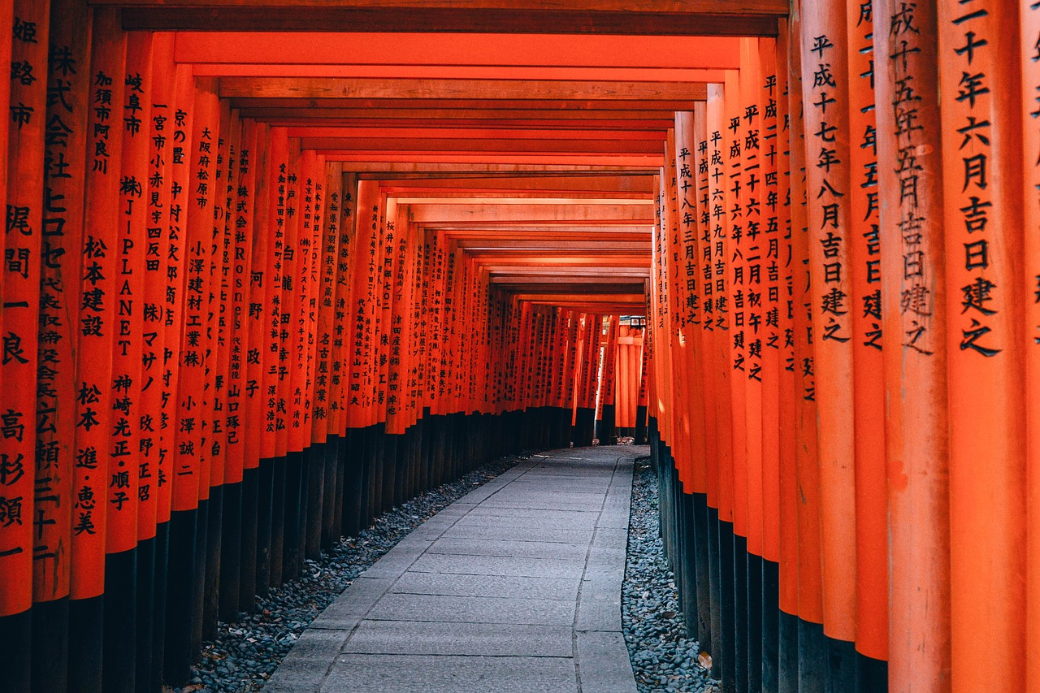
CES Japanese
日本語
Intermediate Class
Session 11

Slide 2
日本語
February 14

Slide 3
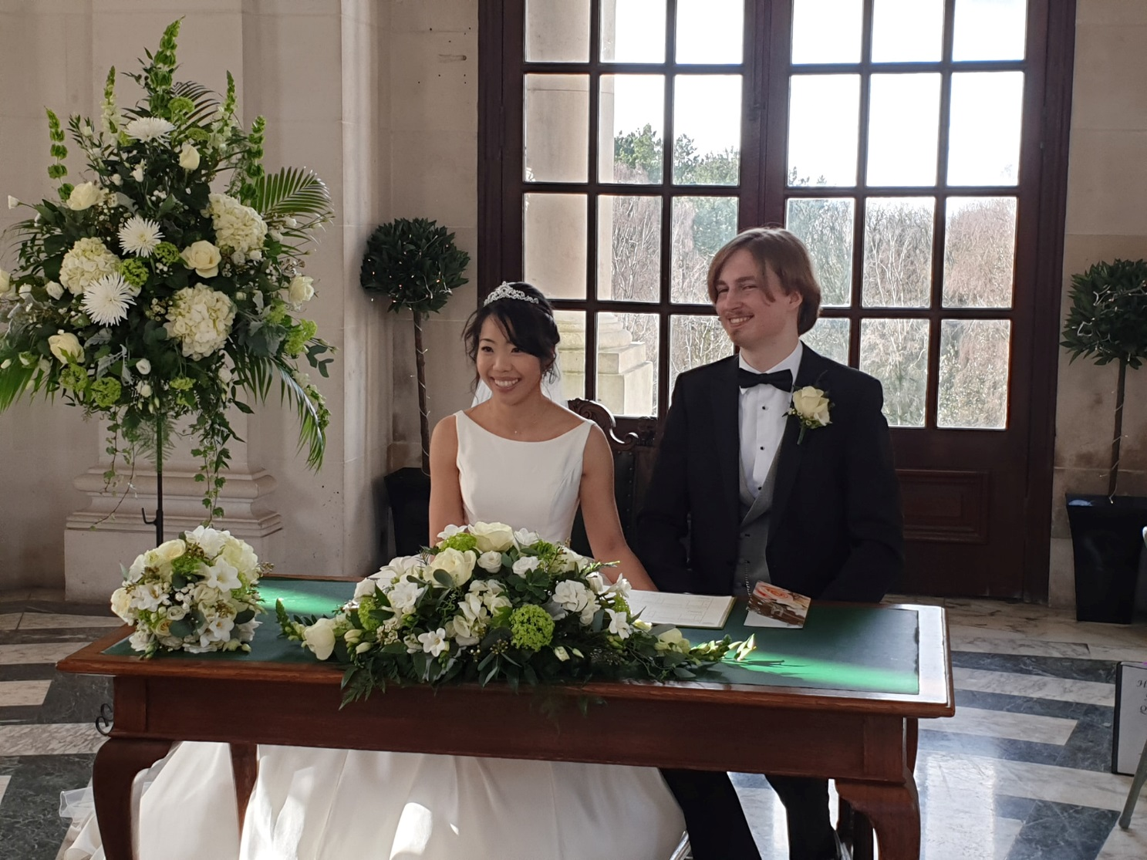
Yuko & George
gokekkon omedetou!

Slide 4
Today’s Journey
Natural World
Listening comprehension

Slide 5
