Slide 1
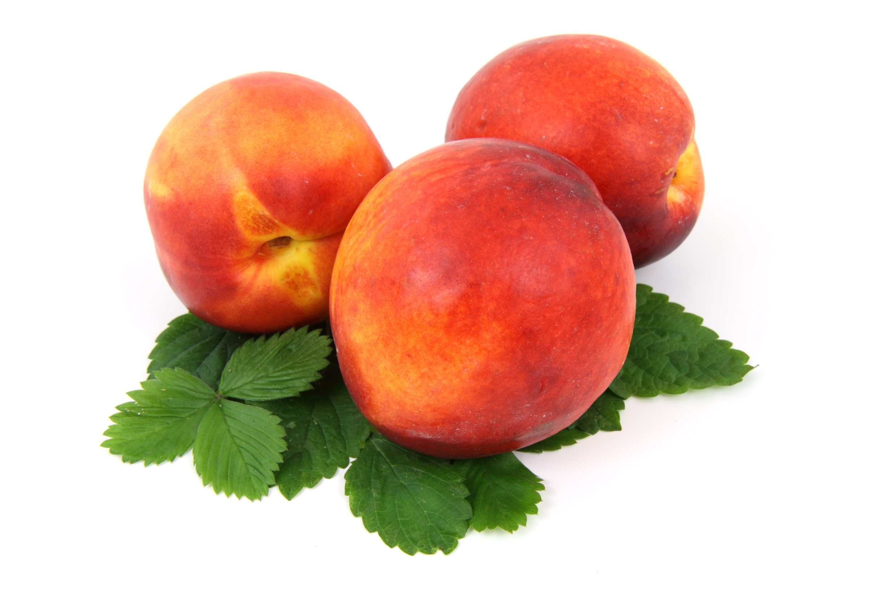
Beginners Class
Session 15
CES Japanese
日本語

Slide 2
Today’s Menu
Review (incl. particles)
Connections
Combinations
Conjunctions

Slide 3
Going Places 行きます いきます
いきます ikimasu go
いきません iki not go
masen
いきました iki went
mashita
いきません でした iki didn’t go
masen deshita

Slide 4
Going Places 行きます いきます
いきたい です iki want to go
tai desu
いきましょう iki Let’s go!
mashō
いけ ik Go!
e

Slide 5
Want: Verbs
いきたい です ikitai desu want to go
たべたい です tabetai desu want to eat
のみたい です nomitai desu want to drink

Slide 6
Verbs: Examples
I did not go to class.
We watched a movie.
Let’s eat.
Shall we study?
I want to study calligraphy.
えいが 映画 eiga film
みます 見ます mimasu watch
勉強 します benkyō shimasu study

Slide 7
Review: Particles
When/how do we use the following?
wa | は
ga | が
wo | を
ni | に
e | へ
made | まで
kara | から
de | で

Slide 8
Review: Particles
When/how do we use the following?
wa | は | topic identifier (“As for…”)
ga | が | topic identifier
wo | を | Identifies the object of an action etc.
ni | に | To (moving, time) At (location, time)
e | へ | To (moving )
made | まで | Until (time) Destination (moving)
kara | から | From (moving, time)
de | で | Location of an action What you have used (e.g. pen, train)

Slide 9
Which particle?
I will go to the station tomorrow.
Watashi __ ashita eki __ ikimasu.
The cat ate a goldfish yesterday.
Neko __ kinō kingyo __ tabemashita.

Slide 10
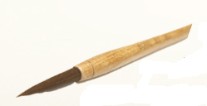
Which particle?
Where will you play on Sunday?
Nichiyōbi __ doko__ asobimasu ka?
Tim will write his name with a brush.
Tim __ fude __ namae __ kakimasu.

Slide 11
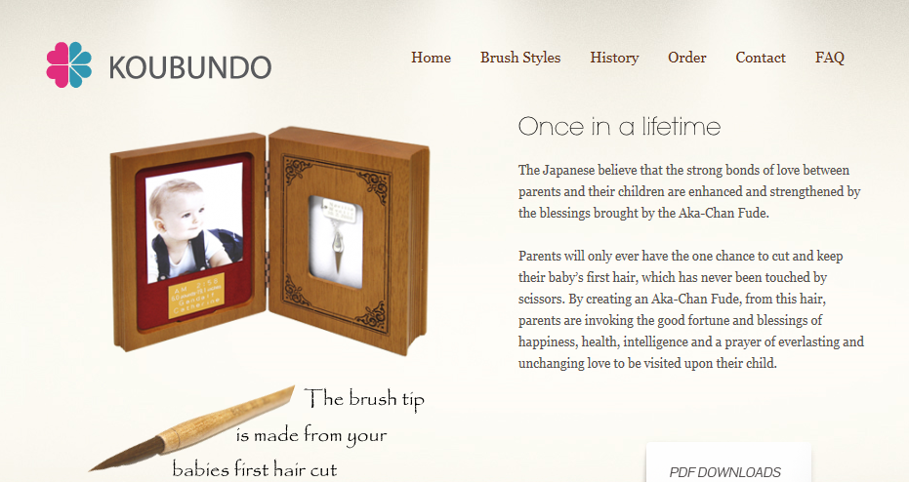

Slide 12
Connections
We’ve looked at constructing sentences
We’ve learned the names for objects and adjectives
Taking the next step involves being able to combine phrases and ideas

Slide 13
Two Objects: …and… と
I bought some paper and a pencil.
私 は 紙 と 鉛筆 を 買いました。
Watashi wa kami to enpitsu wo kaimashita.

Slide 14
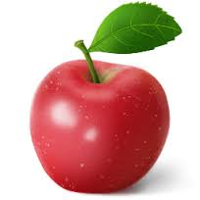
Two Adjectives: …and…
The apple is red and sweet.
りんご は 赤くて 甘い です。
Ringo wa akakute amai desu.

Slide 15
Two Adjectives: …and…
-i adjectives: -i → -kute
e.g. takai → takakute
-na adjectives: add de
e.g. kirei → kirei de
Note: this is for all but the last adjective in a list

Slide 16
Two Adjectives: …and…
For example:
My desk is large, sturdy and clean.
私 の 机 は 大きくて, 丈夫で, きれいです。
Watashi no tsukue wa ōkikute, jōbu de,
kirei desu.

Slide 17
Two Adjectives: Your Turn
That cat is young and energetic.
Young: wakai Energetic: genki (na)
Sono neko wa wakakute, genki desu.
その 猫 は 若くて, 元気 です。
What about the reverse order?

Slide 18
Two Adjectives: Your Turn
Kobe beef is famous and delicious.
Famous: yūmei (na) Delicious: oishii
Kōbe bīfu wa yūmei de, oishii desu.
神戸ビーフ は 有名 で、美味しい です。
What about the reverse order?

Slide 19
Sequence of Verbs: -te form
I went to the library and read a book.
図書館 に 行って, 本 を 読みました。
Toshokan ni itte hon wo yomimashita.

Slide 20
The -te form
Similar to the plain past tense
Replace the –ta with –te
Polite: tabemashita Plain: tabeta
I ate: tabeta
→ tabete (-te form)

Slide 21
The -te form…can be -de !
Similar to the plain past tense
Replace the –da with -de
Polite: yomimashita Plain: yonda
I read: yonda
→ yonde (-de form)

Slide 22
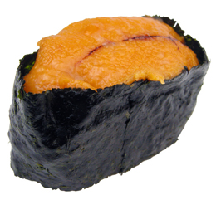
Sequence of Verbs: -te form
For example:
I ate sea urchin and became ill.
ウニ を 食べて, 病気 に なりました。
Uni wo tabete, byōki ni narimashita.

Slide 23
Sequence of Verbs: -te form
This form also works for the future:
I will go to the restaurant and eat ramen.
レストラン に 行って, ラーメン を 食べます.
Resutoran ni itte, ramen wo tabemasu.

Slide 24
Sequence of Verbs: -te form Your turn!
What combinations can you come up with?
Ask if you’d like to know any vocabulary, or the plain past form of a verb

